Slide 1
The importance of cleaning shared medical equipment in General Practice (GP)

Slide 2
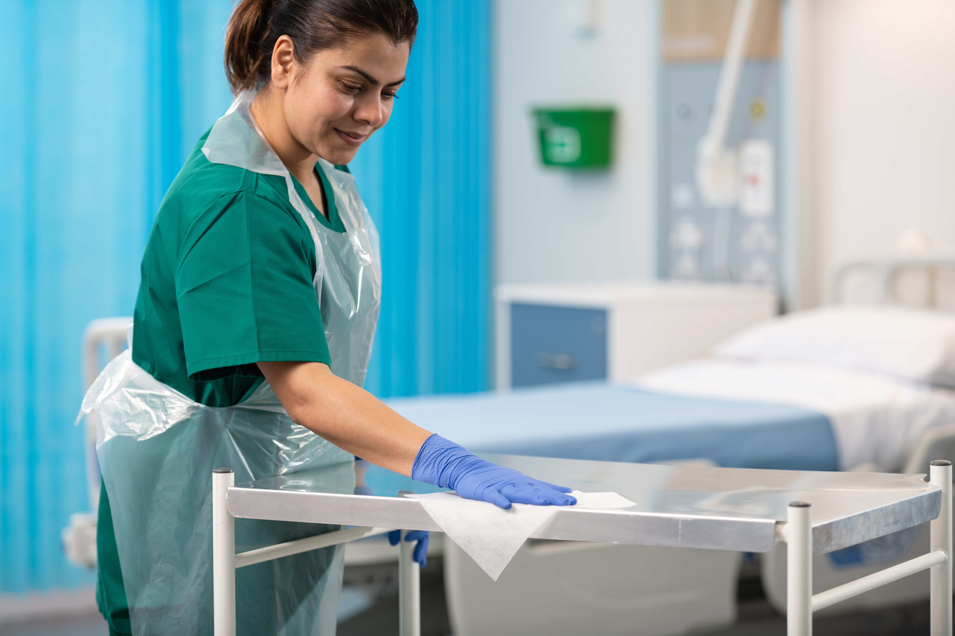
Workshop objectives
At the end of this workshop, participants will be able to:
Explain the role of environmental cleaning and disinfection in supporting infection prevention and RACGP compliance
Understand the difference between cleaning
and disinfection
Apply the five principles of effective cleaning, including correct contact time
Identify risk zones within a General Practice
Select the appropriate cleaning and disinfection product for different clinical areas
Understand cleaning responsibilities and the importance of documentation

Slide 3
Why should we clean?
Environmental cleaning is one of the most effective ways to prevent the spread of infection in General Practice.
Effective cleaning helps to:
Protect patients, staff, visitors and the community from harmful microorganisms
Reduce the risk of healthcare-associated infections (HAIs)
Support RACGP accreditation by demonstrating compliance with RACGP Criterion 4.1 Infection Prevention and Control Standards¹
1. Royal Australian College of General Practitioners. Criterion GP4.1 – Infection prevention and control, including sterilisation. 2020. Available from: https://www.racgp.org.au/running-a-practice/practice-standards/standards-5th-edition/standards-for-general-practices-5th-ed/general-practice-standards/gp-standard-4/criterion-gp4-1-infection-prevention-and-control-i.

Slide 4
Healthcare-associated infections (HAIs) in Australia
>170,500
Healthcare-associated infections in Australian
acute healthcare facilities each year¹
“The problem does not just affect patients and workers in hospitals —
HAIs can occur in any healthcare setting, including office-based practices (e.g. general practice clinics, dental clinics, community health facilities), the setting in which paramedics work and long-term care facilities.²”
National Health and Medical Research Council. Australian Guidelines for the Prevention and Control of Infection in Healthcare. 2019.
Available from: https://www.nhmrc.gov.au/about-us/publications/australian-guidelines-prevention-and-control-infection-healthcare-2019
National Health and Medical Research Council. Preventing Infection. 2024. Available from: https://www.nhmrc.gov.au/health-advice/public-health/preventing-infection

Slide 5
Healthcare-associated infections (HAIs) in Australia
>7500 deaths
per year¹
This is 6.5 times higher than the Australian road toll in 2021
1. Lydeamore MJ, Mitchell BG, Bucknall T, Cheng AC, Russo PL, Stewardson AJ. Burden of five healthcare associated infections in Australia. Antimicrob Resist Infect Control. 2022(11:69). doi: 10.1186/s13756-022-01109-8

Slide 6
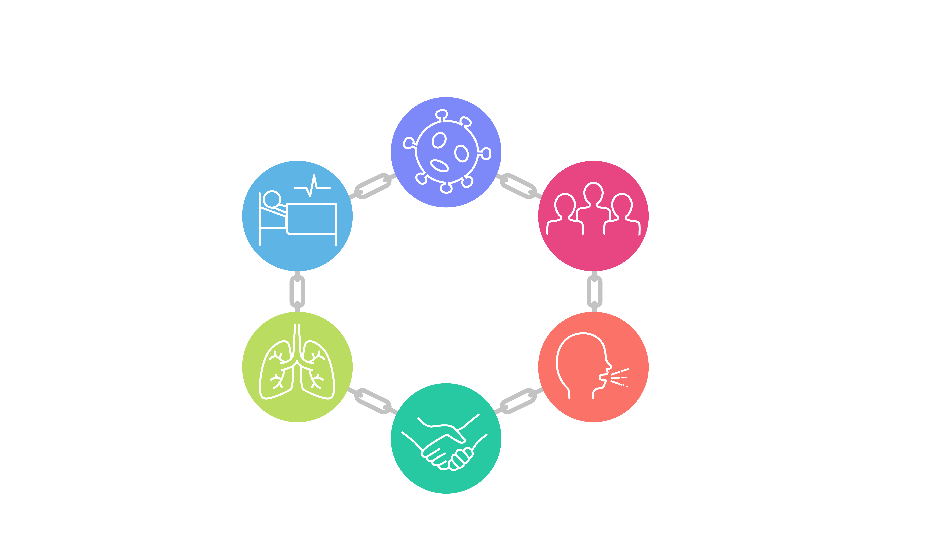
Chain of infection overview
Germ/pathogen
Susceptible host
Reservoir
Portal of entry
Portal of exit
Mode of transmission
(NHMRC, 2019)
Notes:
Summarise:
We know germs can easily be found on our hands and be transferred from person to person or to surfaces.
We know germs can survive for long periods of time on surfaces if not cleaned and disinfected well.
And we know that germs don’t stick to the patient within a room, they are shed and dropped on to equipment and surfaces.
We also know that some germs multiply very quickly. For instance – E.coli doubles every 20 minutes. So just one E.coli bacteria can become over 2 million bacteria in just 7 hours.
Again, this is why it is important to clean daily. Each time you clean you reduce the amount of germs on a surface to a safer level. The more germs on a surface, the more can be picked up and spread throughout the facility.
Clean to reduce the bioburden

Slide 7




Chain of infection –
Breaking the chain
Hand hygiene
Precautions
Cleaning & disinfection
(NHMRC, 2019)
Notes:
Summarise:
We know germs can easily be found on our hands and be transferred from person to person or to surfaces.
We know germs can survive for long periods of time on surfaces if not cleaned and disinfected well.
And we know that germs don’t stick to the patient within a room, they are shed and dropped on to equipment and surfaces.
We also know that some germs multiply very quickly. For instance – E.coli doubles every 20 minutes. So just one E.coli bacteria can become over 2 million bacteria in just 7 hours.
Again, this is why it is important to clean daily. Each time you clean you reduce the amount of germs on a surface to a safer level. The more germs on a surface, the more can be picked up and spread throughout the facility.
Clean to reduce the bioburden

Slide 8
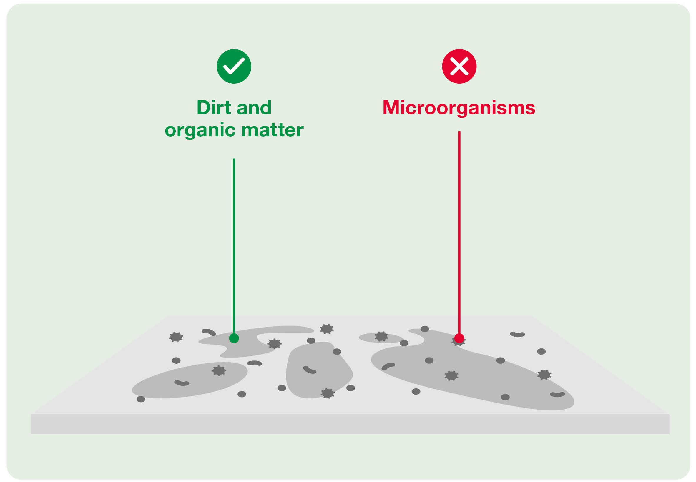

Cleaning process
Uses detergents to physically remove dirt, dust and organic matter.
Use when:
Routine cleaning is all that’s required
Otter J, Galletly T (2018) Environmental decontamination 3: auditing cleaning and disinfection. Nursing Times [online]; 114: 9, 25-28

Slide 9
Disinfection process
Uses chemical biocides (disinfectants) to kill germs
Use when:
Cleaning high touch surfaces, shared equipment or examination spaces
Contamination is suspected
Otter J, Galletly T (2018) Environmental decontamination 3: auditing cleaning and disinfection. Nursing Times [online]; 114: 9, 25-28

Slide 10
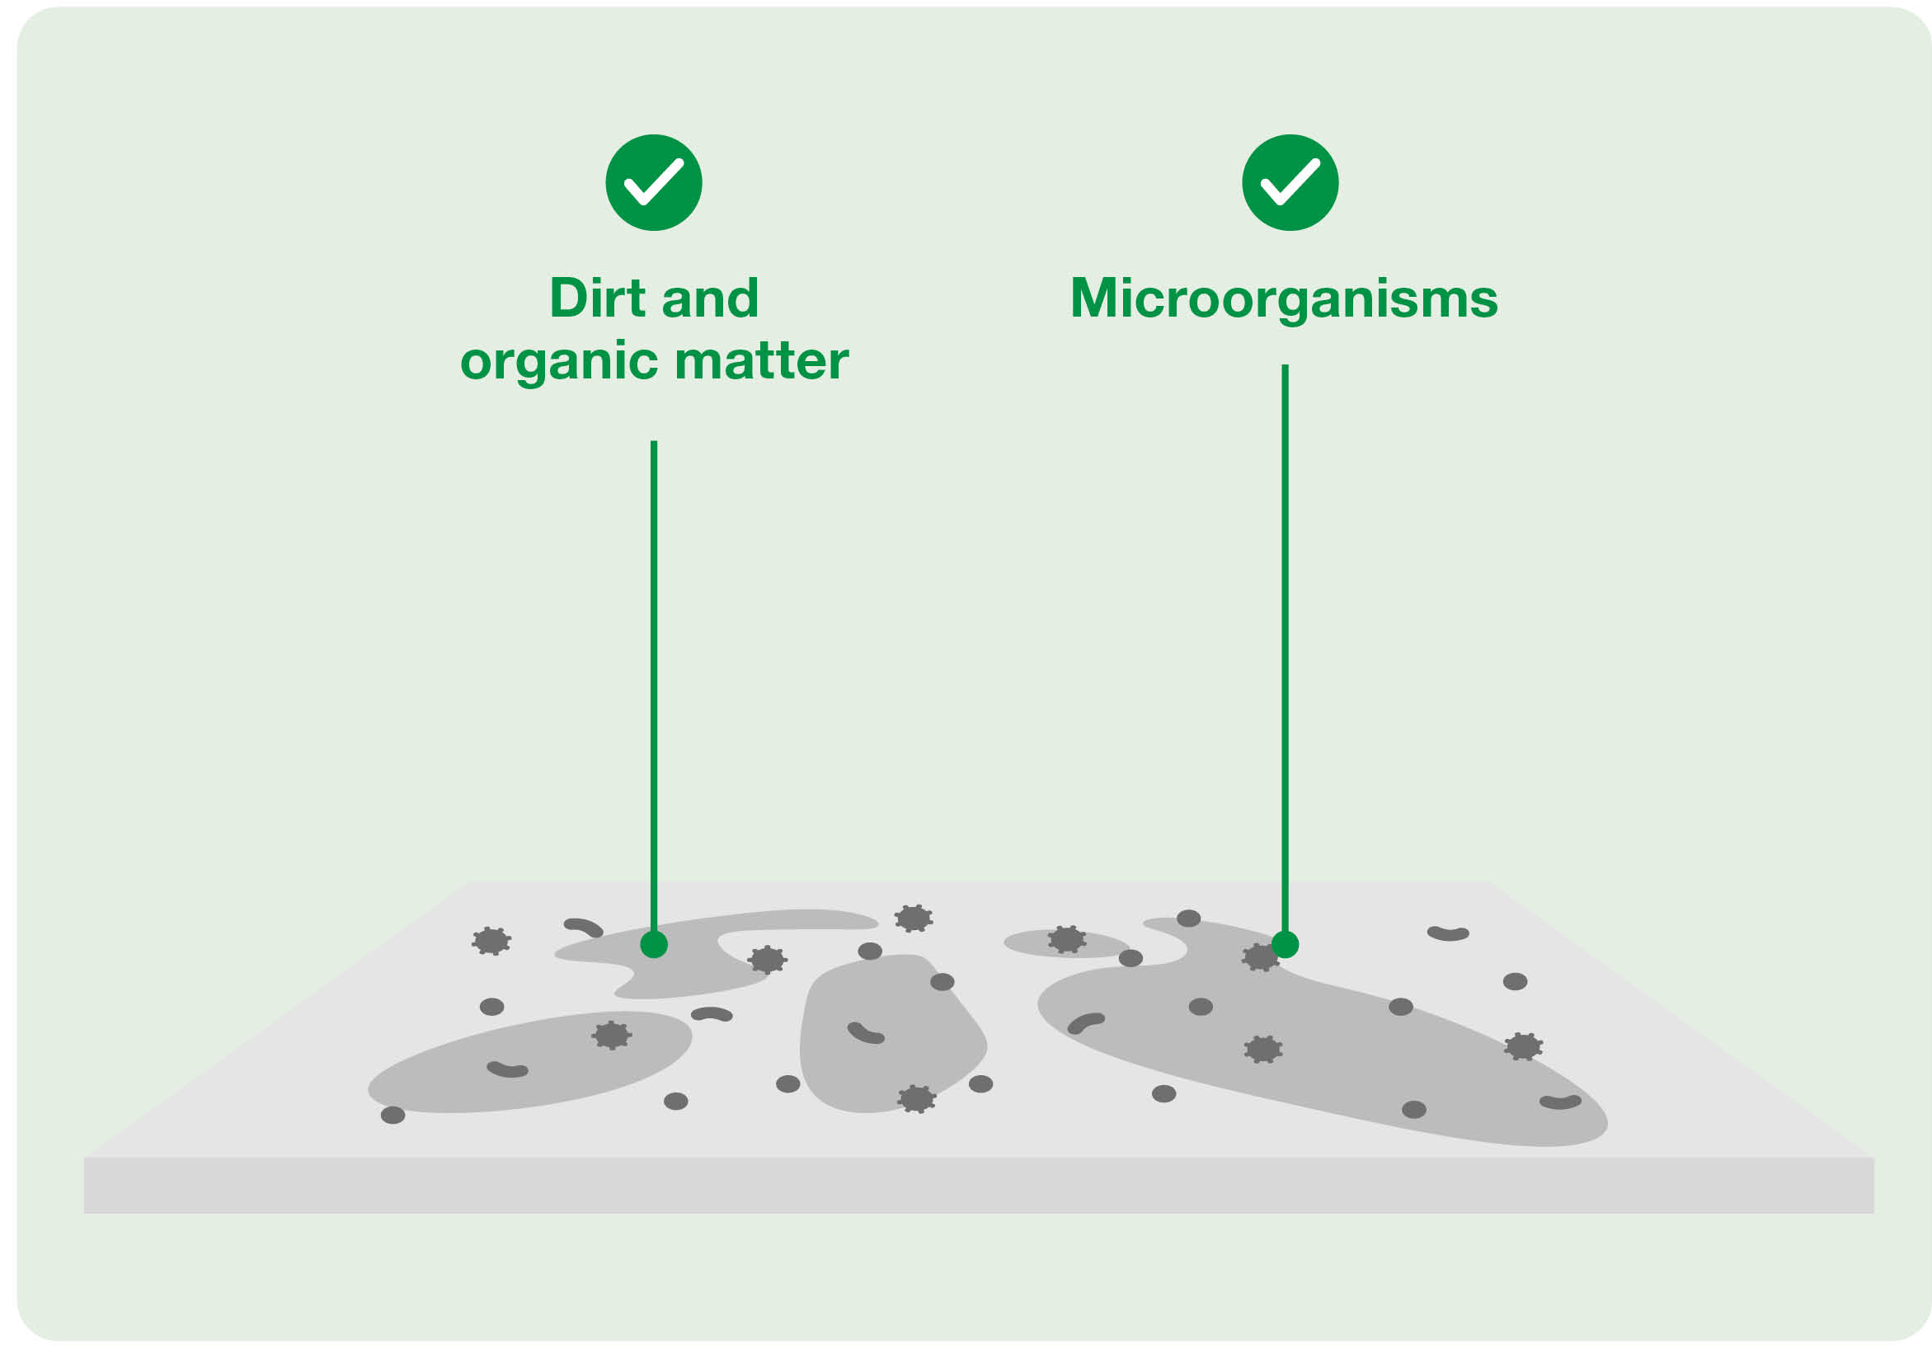

Clean and disinfect
Uses cleaning and disinfection agents to remove dirt, organic matter and microorganisms
Options:
2-step protocol (clean then disinfect)
1-step protocol (clean and disinfect)
Otter J, Galletly T (2018) Environmental decontamination 3: auditing cleaning and disinfection. Nursing Times [online]; 114: 9, 25-28

Slide 11





The 5 principles of cleaning
Inadequate cleaning will not reduce the risk of infection but may even enhance it!
Wipe using an
‘S’ shaped pattern
Work from top
to bottom
Wipe from
clean to dirty
Ensure correct
contact time
One wipe,
one surface

Slide 12
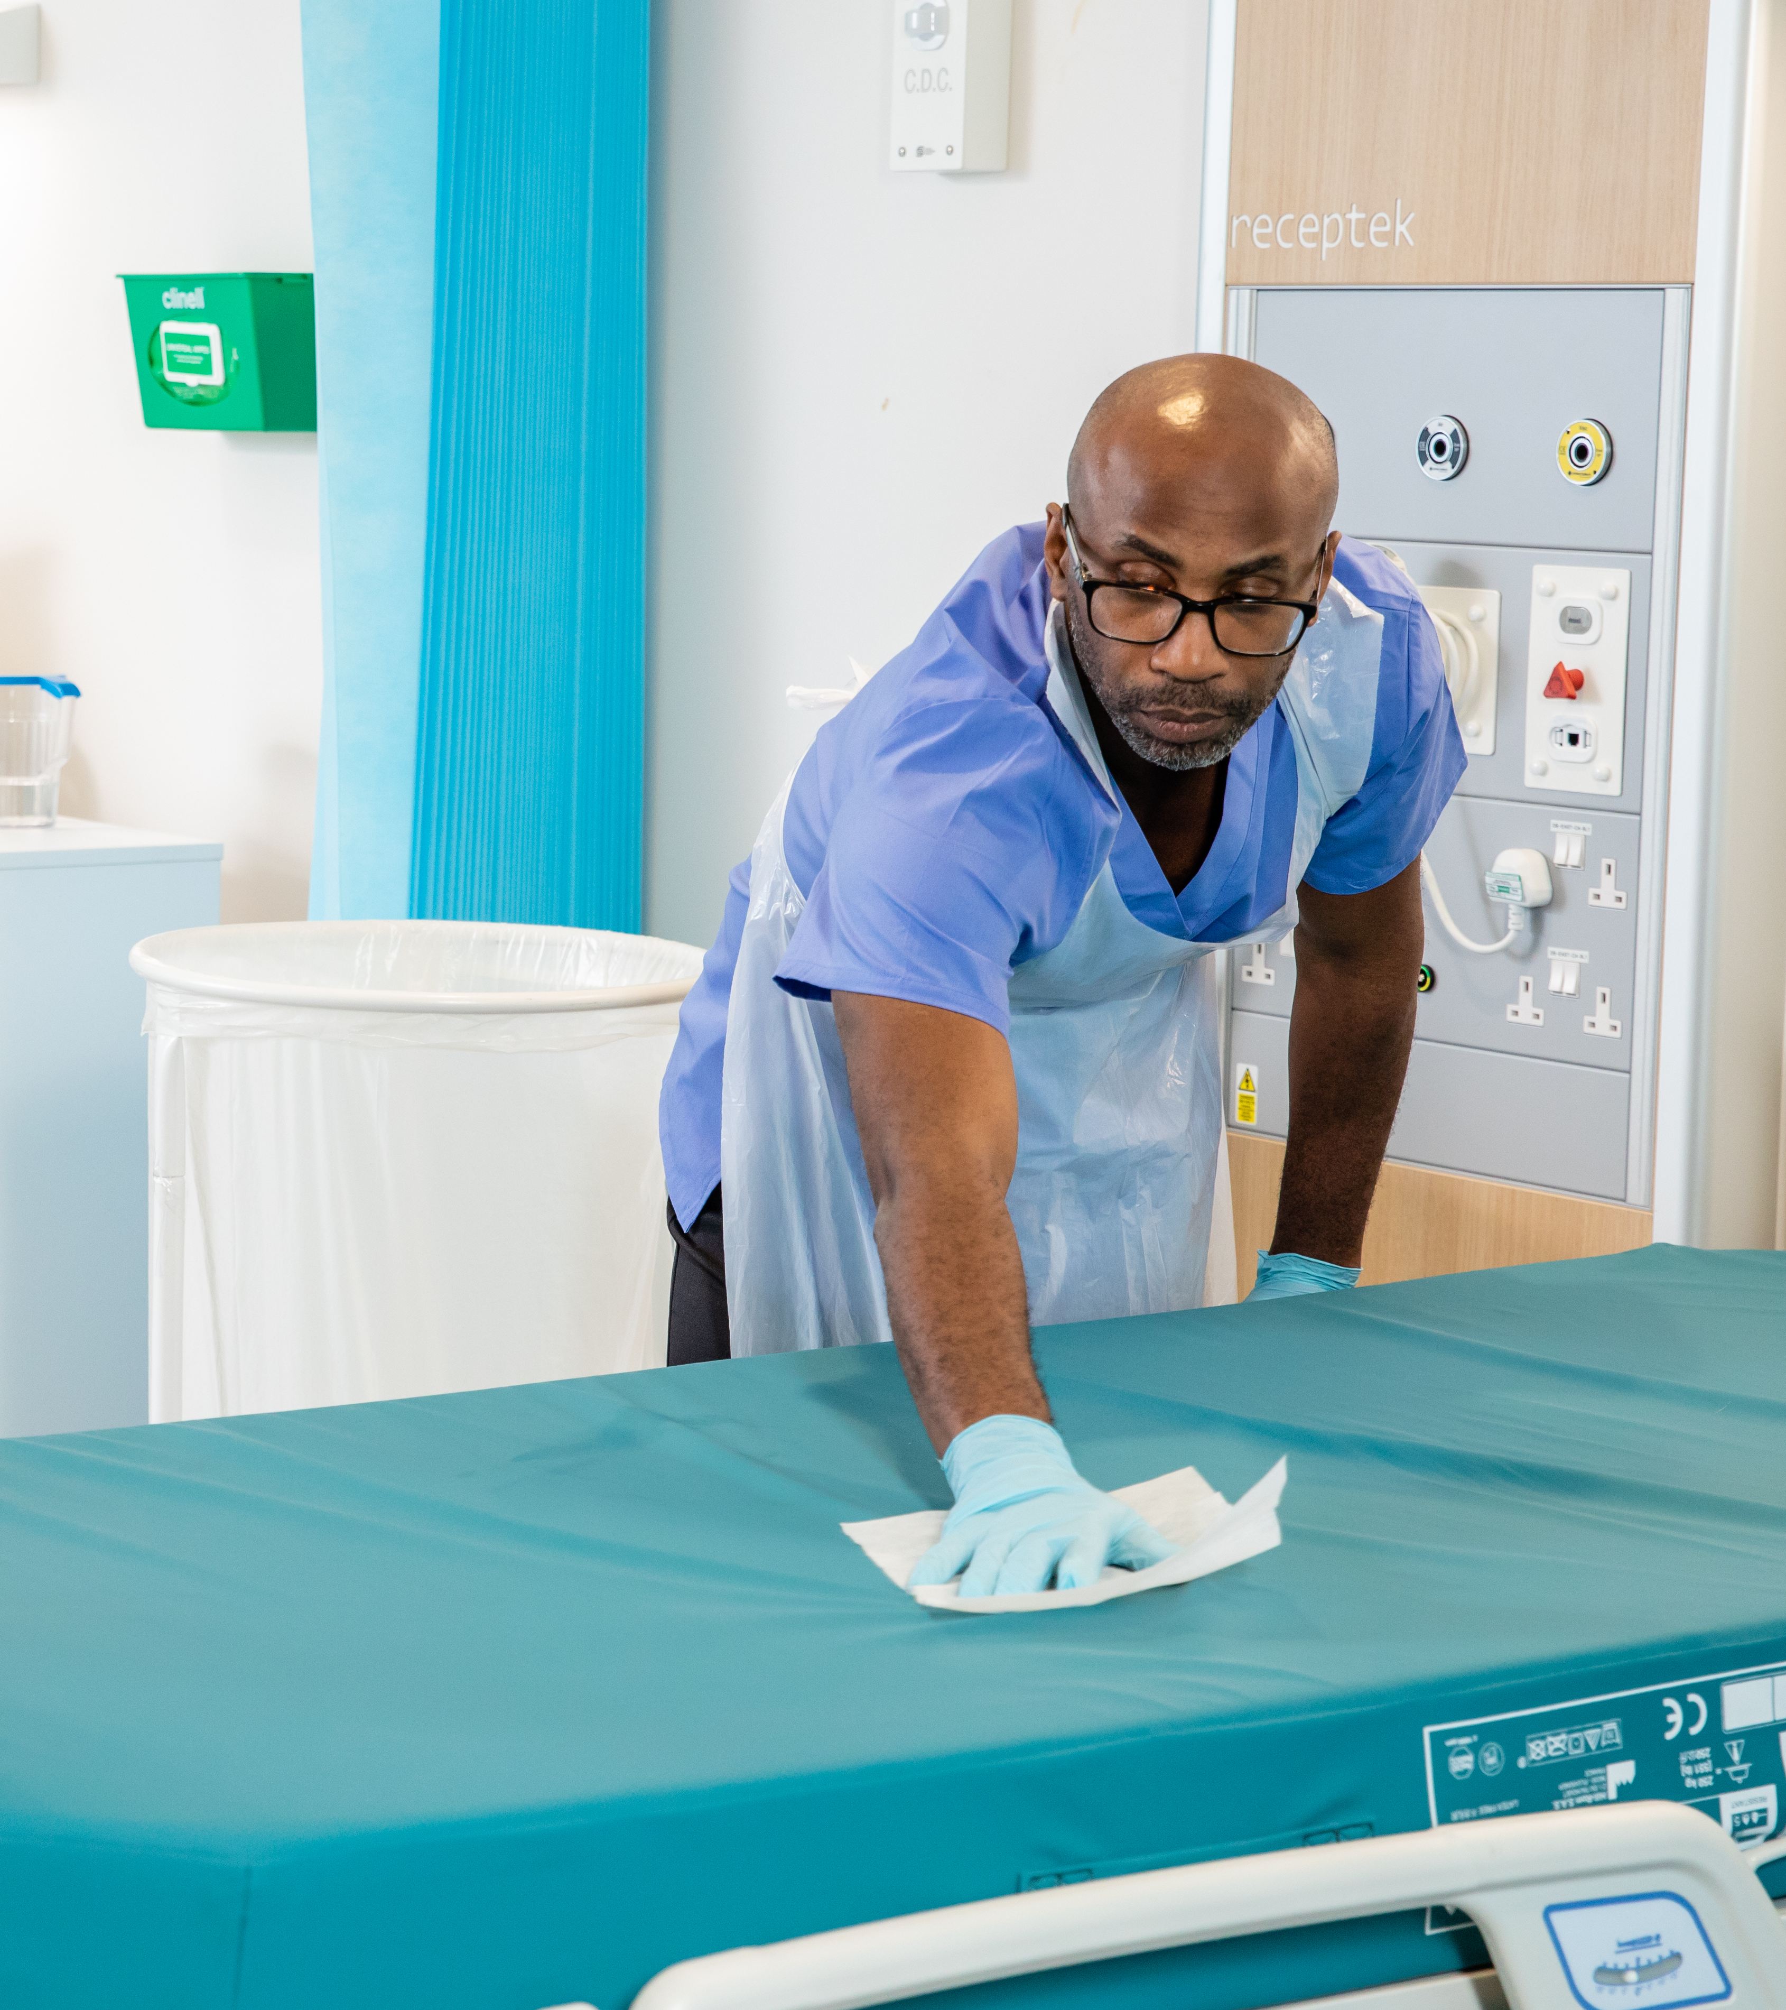
The 5 principles of cleaning
1
Wipe using an
‘S’ shaped pattern
Wiping in an ‘S’ shaped pattern prevents contamination of areas already cleaned, and ensures the entire areas are covered

Slide 13
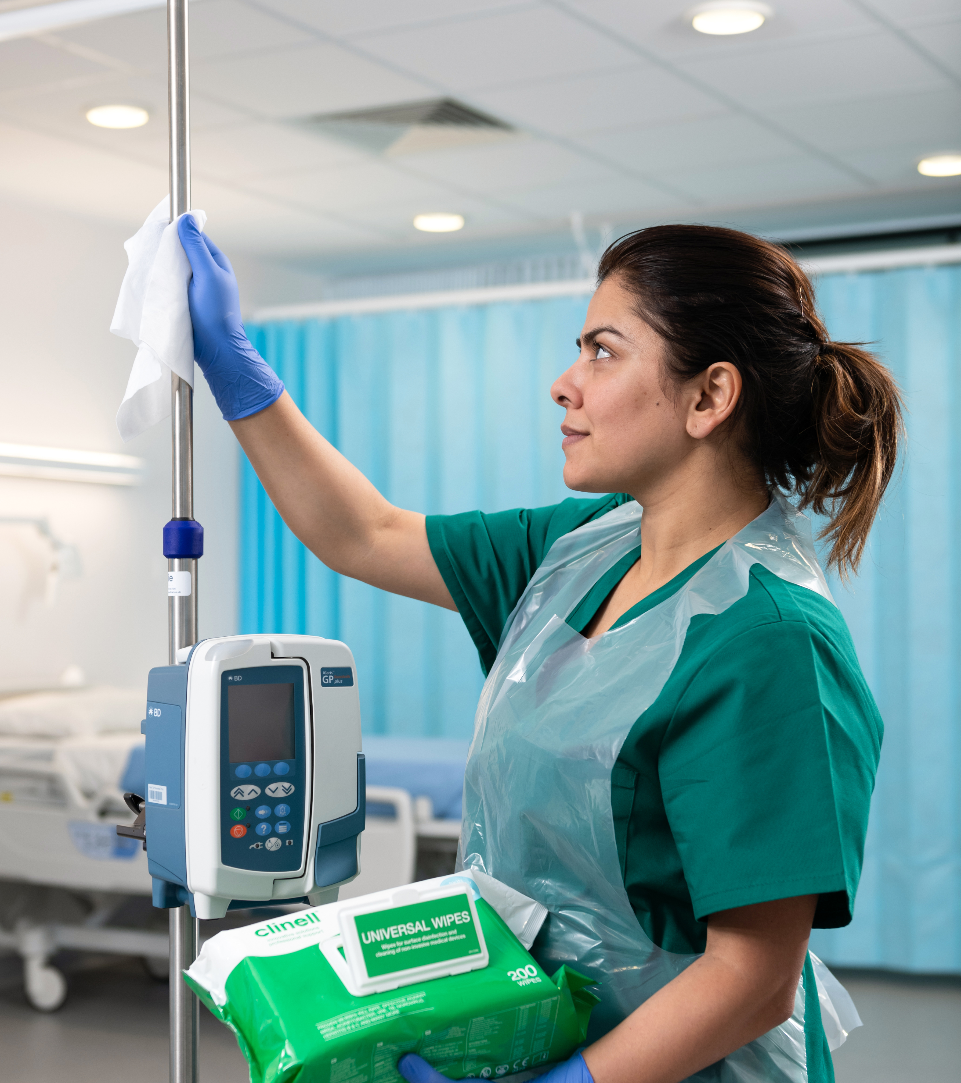
The 5 principles of cleaning
2
Work from top
to bottom
Cleaning from top to bottom ensures
dirtier areas are cleaned last and
reduces risk of transferring pathogens
to an already cleaned area

Slide 14
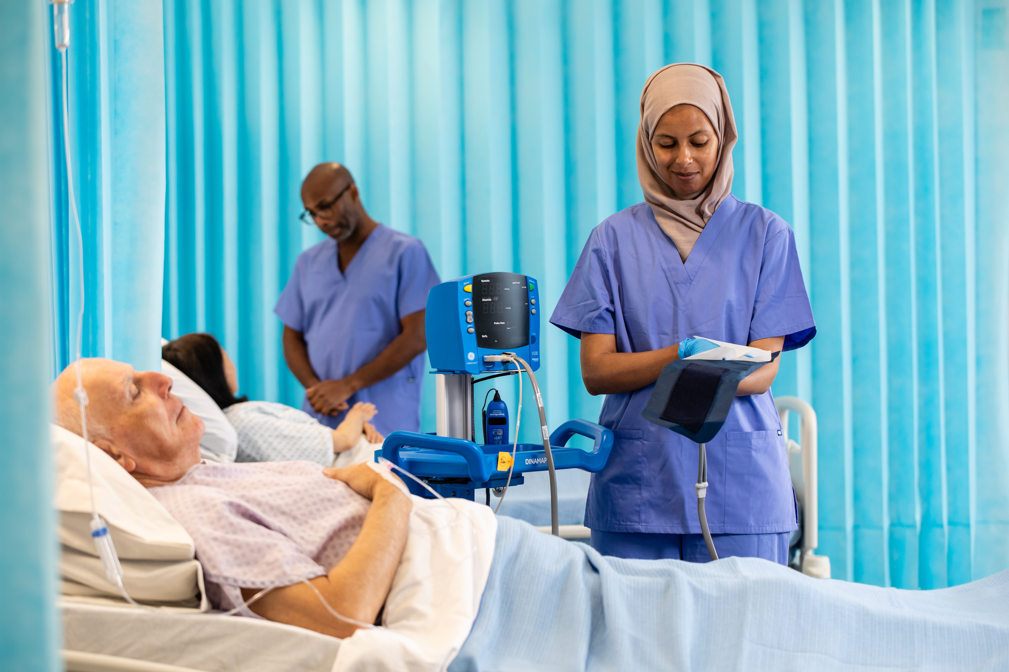
The 5 principles of cleaning
3
Wipe from
clean to dirty
Pathogens are picked up on cleaning cloths/wipes as cleaning occurs.
Wiping from clean to dirty avoids introducing pathogens to clean surfaces
Wiping in an S-shaped pattern prevents contamination of areas already cleaned, and ensures the entire areas are covered

Slide 15

The 5 principles of cleaning
What is contact time?
Contact time is the time a surface needs to remain wet for the disinfectant to work effectively.
Wiping a surface dry before the stated contact time means the product may not have enough time
to achieve its intended efficacy.
4
Ensure correct contact time
Always follow the manufacturer's recommended contact time.

Slide 16
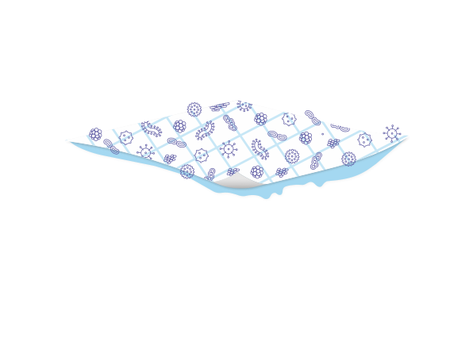
The 5 principles of cleaning
A wipe or cleaning cloth can become contaminated and overloaded with microorganisms.
5
One wipe,
one surface
After each surface is cleaned, or if
the wipe becomes dry or dirty, throw the old wipe away and use a new one

Slide 17
RACGP accreditation and infection prevention and control (IPC)
RACGP Criterion GP4.1 states that GP clinics must have:
GP4.1 A: A clinical team member responsible for IPC procedures
GP4.1 B: A documented Infection Prevention and Control (IPC) policy
GP4.1 C: A clinical team member responsible for IPC education
GP4.1 D: All team members must manage risks of potential cross-infection in the practice
GP4.1 E: Patients to be informed about respiratory etiquette, hand hygiene, precautionary techniques
Royal Australian College of General Practitioners. Criterion GP4.1 – Infection prevention and control, including sterilisation. 2020. Available from: https://www.racgp.org.au/running-a-practice/practice-standards/standards-5th-edition/standards-for-general-practices-5th-ed/general-practice-standards/gp-standard-4/criterion-gp4-1-infection-prevention-and-control-i.

Slide 18
RACGP
GP4.1 A
Practices must have at least one clinical team member with the responsibility of:
Leading and coordinating IPC processes across the practice
Maintaining an adequate supply of TGA-approved disinfectant supplies & check expiry
Ensuring reusable equipment is cleaned, sterilised and stored correctly
Following waste management processes
Royal Australian College of General Practitioners. Criterion GP4.1 – Infection prevention and control, including sterilisation. 2020. Available from: https://www.racgp.org.au/running-a-practice/practice-standards/standards-5th-edition/standards-for-general-practices-5th-ed/general-practice-standards/gp-standard-4/criterion-gp4-1-infection-prevention-and-control-i.

Slide 19
RACGP
GP4.1 B
Practices must have a written, practice-specific IPC policy:
To be reviewed annually
Conduct regular audits to confirm compliance
Consult with GP team in developing the policy
Royal Australian College of General Practitioners. Criterion GP4.1 – Infection prevention and control, including sterilisation. 2020. Available from: https://www.racgp.org.au/running-a-practice/practice-standards/standards-5th-edition/standards-for-general-practices-5th-ed/general-practice-standards/gp-standard-4/criterion-gp4-1-infection-prevention-and-control-i.

Slide 20
RACGP
GP4.1 C
Practices must have a clinical team member responsible for IPC education, including:
Induction on IPC policies and cleaning procedures for new staff
Conducting IPC training and competency assessments
Documenting cleaning records to demonstrate compliance
Royal Australian College of General Practitioners. Criterion GP4.1 – Infection prevention and control, including sterilisation. 2020. Available from: https://www.racgp.org.au/running-a-practice/practice-standards/standards-5th-edition/standards-for-general-practices-5th-ed/general-practice-standards/gp-standard-4/criterion-gp4-1-infection-prevention-and-control-i.

Slide 21
RACGP
GP4.1 D
All members of the practice team manage risks of potential cross-infection, including:
Good hand hygiene practices
PPE use
Triage of patients with infections
Royal Australian College of General Practitioners. Criterion GP4.1 – Infection prevention and control, including sterilisation. 2020. Available from: https://www.racgp.org.au/running-a-practice/practice-standards/standards-5th-edition/standards-for-general-practices-5th-ed/general-practice-standards/gp-standard-4/criterion-gp4-1-infection-prevention-and-control-i.

Slide 22
RACGP
GP4.1 E
Patients to be informed about respiratory etiquette, hand hygiene, precautionary techniques:
Have hand washing facilities, hand sanitiser, tissues and rubbish bins available
Brochures or posters displayed explaining respiratory etiquette and hand hygiene processes
Royal Australian College of General Practitioners. Criterion GP4.1 – Infection prevention and control, including sterilisation. 2020. Available from: https://www.racgp.org.au/running-a-practice/practice-standards/standards-5th-edition/standards-for-general-practices-5th-ed/general-practice-standards/gp-standard-4/criterion-gp4-1-infection-prevention-and-control-i.

Slide 23
Standard risk-based cleaning guide
Risk level | Zones and areas | Recommended approach | Product
High risk | Treatment rooms, consultation rooms, shared medical equipment, procedure areas | Clean and disinfect between every patient, and immediately after any visible contamination | 2-in-1 detergent & disinfectant wipe
Moderate risk | Patient-facing reception counters, waiting room touchpoints, door handles, bathrooms, staff workstations | Clean and disinfect at least daily, more frequently on high-touch surfaces | 2-in-1 detergent & disinfectant wipe
Low risk | Back-of-house administration areas, meeting rooms, storage areas | Clean daily with detergent; disinfect if visibly contaminated or after a known infectious exposure | Detergent or 2-in-1 detergent & disinfectant wipe
Example risk categories based on the principles of the RACGP Infection Prevention and Control Guidelines.
Practices should undertake their own risk assessment. Cleaning frequency and product selection should be adapted based on specific precautions, infection risks and outbreak situations.
Royal Australian College of General Practitioners. Criterion GP4.1 – Infection prevention and control, including sterilisation. 2020. Available from: https://www.racgp.org.au/running-a-practice/practice-standards/standards-5th-edition/standards-for-general-practices-5th-ed/general-practice-standards/gp-standard-4/criterion-gp4-1-infection-prevention-and-control-i.

Slide 24
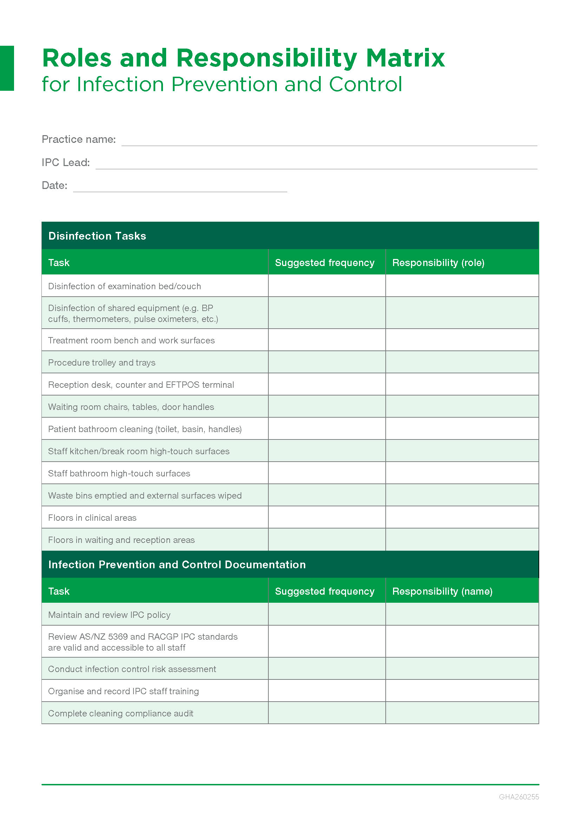
Roles and responsibilities
Each staff member will have a designated cleaning area
Product to be used as per risk assessment zones
Frequency to be adhered to

Slide 25
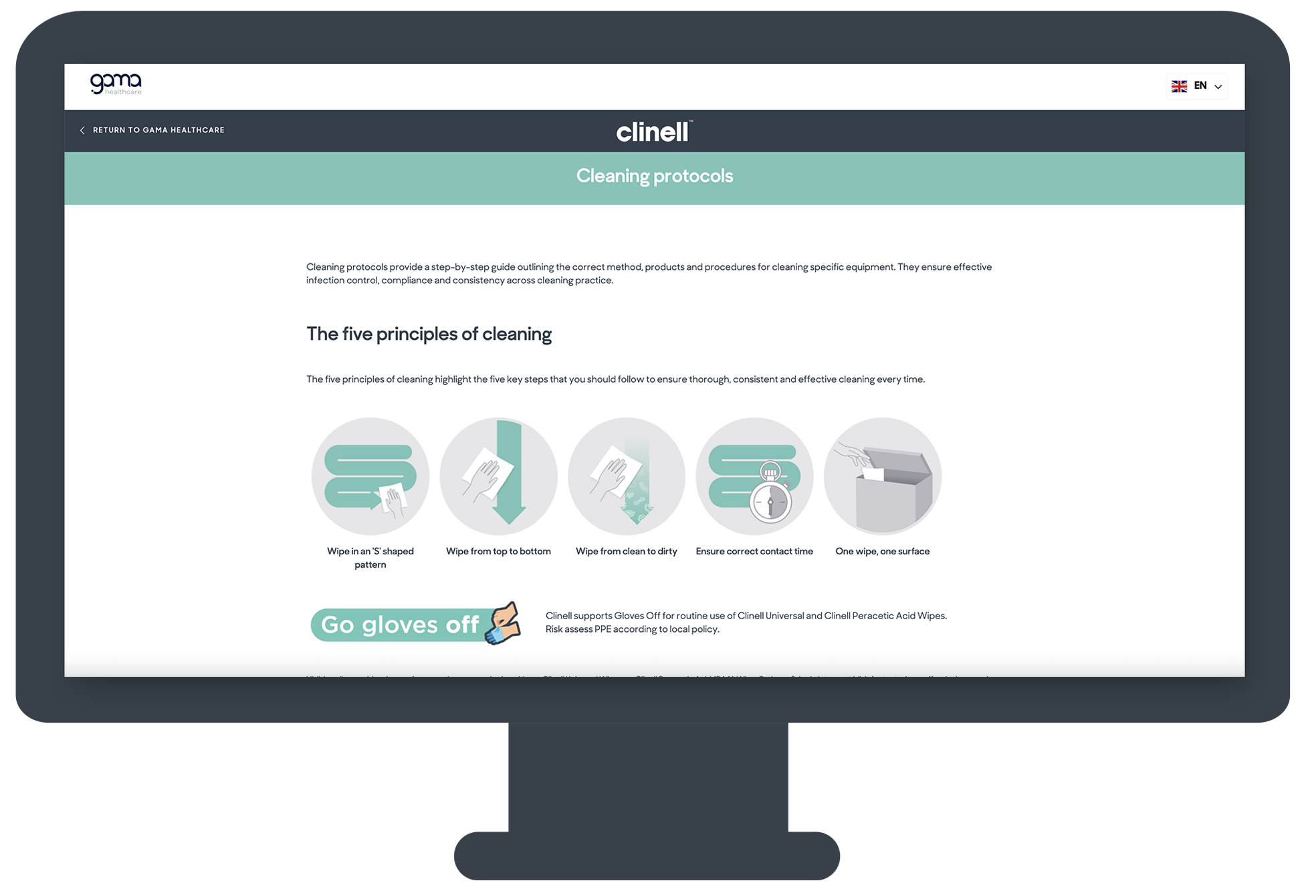

Cleaning protocols
Scan to access:

Slide 26
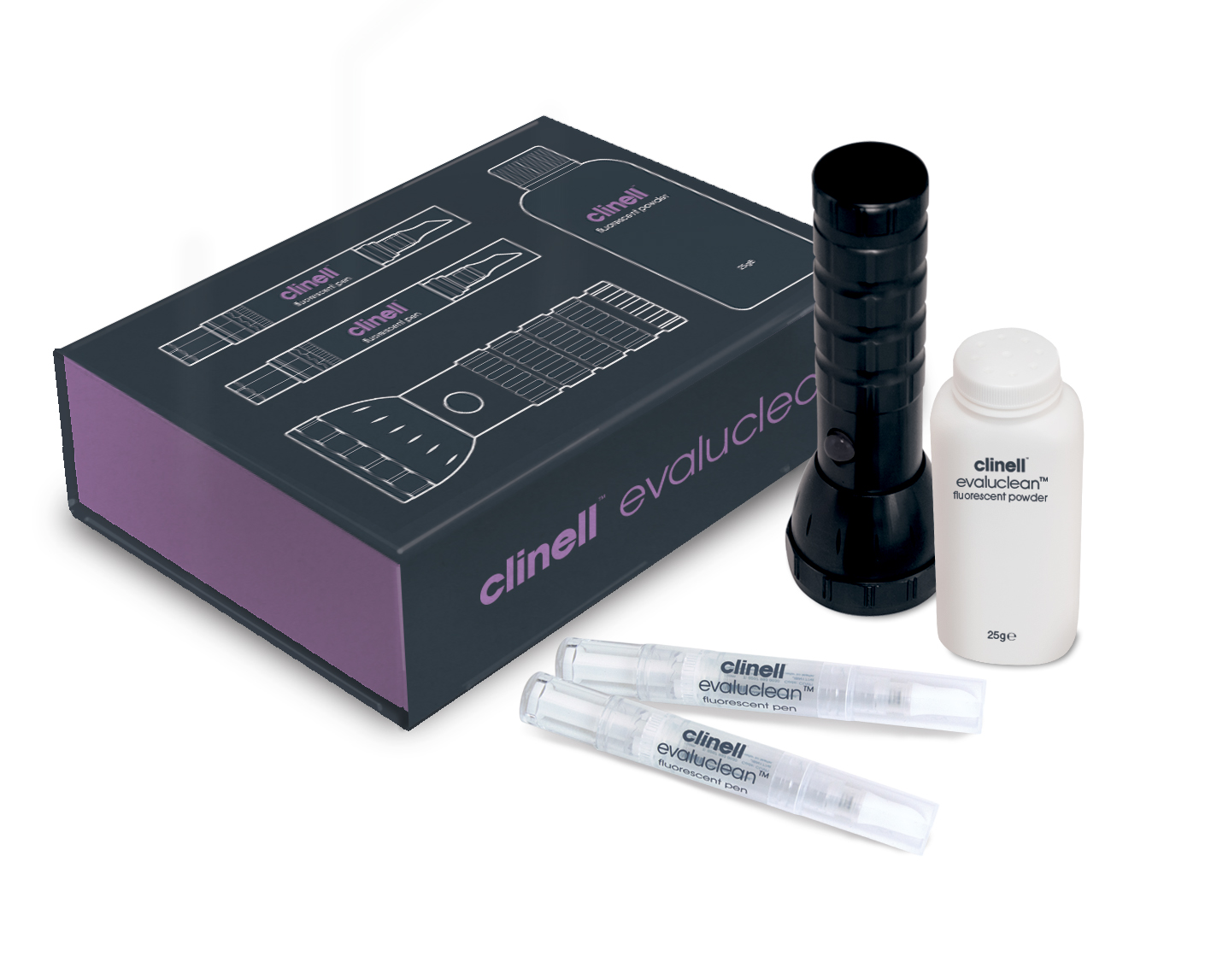
Now, let’s practice
Use the next 10 mins to show how transference occurs with UV powder.
Then get participants to practice cleaning on
pre-marked equipment (UV dots).

